Slide 1
Technical Seminar
On
Building Modern Clouds
Guide:
Prof. Sajitha N
Assistant Professor
By:
Nama Venkata Naga Sukesh
1BG16CS063

Slide 2
Contents
Introduction
Problem statement
Literature survey
System Architecture
Result Analysis
Conclusion

Slide 3
Introduction
The cloud is made up of servers in data centers all over the world and provides convenience to the users accessing it. It reduces the task of maintaining the database and servers by the organisation.
The cloud enables to access the same files and applications by multiple users from different locations.
The computing and storing takes place in the data centers instead of locally on the user device.
Cloud helps to create virtual instances that works similar to the physical computer with its own hardware.

Slide 4
Problem Statement
To build modern clouds using Docker, Kubernetes and Google Cloud Platform, handle Non-Relational Databases on BigQuery.

Slide 5
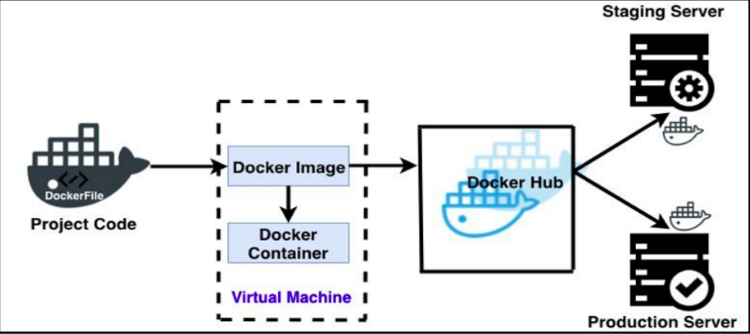
Literature Survey
1.Jay Shah, Dushyant Dubaria, Building Modern Clouds using Docker, Kubernetes & Google Cloud Platform, 2019 IEEE
Using Docker
Docker image
Docker container
Docker hub

Slide 6
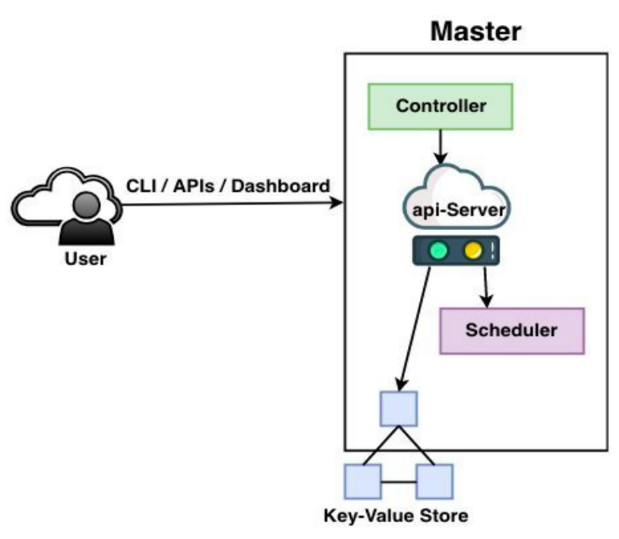
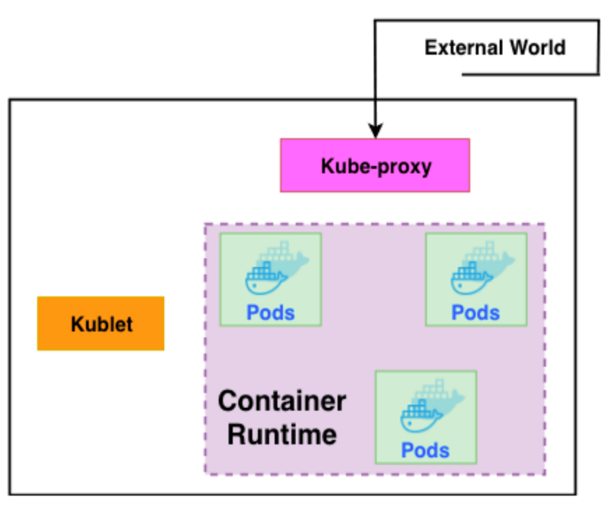
Cont.
Using kubernetes :
Master : Slave :

Slide 7
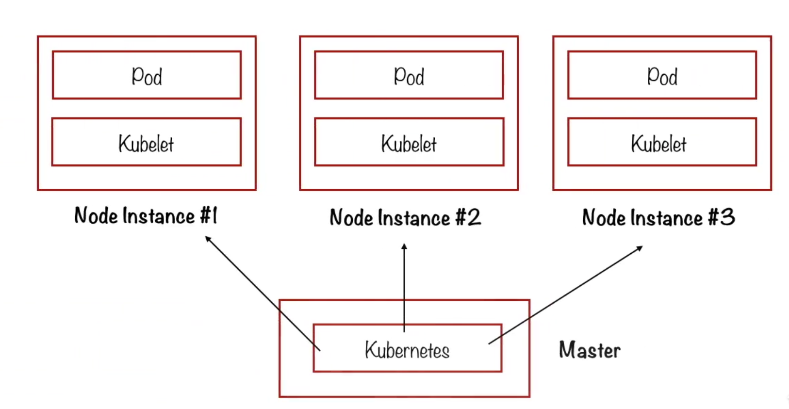
Cont.
Kubernetes cluster :

Slide 8
Cont.
Google Cloud Platform:
Installing and configuring the CLI
Planning and configuring the cloud solution
Planning and Configuring Network Resources
Deployment and implementation App engine and cloud function

Slide 9
Cont.
2. Hera Arif, Hassan Hajjdiabl, Fatima Al Harbi , Mohammed Ghazal, A Comparison between Google Cloud Service and iCloudHera, 2019 IEEE 4th International Conference on Computer and Communication Systems
History of cloud services :
It started in the 1950
1970 - concept of virtualization started
1990 - private virtual environment, multiple users can use one physical infrastructure
2000 - cloud computing flourished
2005 - world entered into cloud computing
2009 - started with google apps

Slide 10
Cont.
History of icloud :
iTools-2000,.Mac-2002,MobileMe-2008
Presented icloud in 2011 and died before launching and it is updated version of MobileMe(20GB for $99 year)
Then it provided free 5GB along with App store, iBookstore, iCloud for backup, iTunes for music
It hired Amazon Web service and Microsoft Azure for icloud services and later shifted some services to Google Cloud

Slide 11
Cont.
History of Google Cloud :
Started cloud service in 2008 with app engine with limited storage of 500 Mb and lack of prominent languages
2010 introduced cloud storage
2011 preview of cloud SQL
2012 introduced Google Cloud Platform
And BigQuery
2013 introduced Google Compute Engine and added growth to App Engine
2016 introduced Dataproc

Slide 12
Cont.
GCP has many features like Compute engine, App engine, kubernetes, replica Pool, Cloud Storage, Datastore(NoSQL), Cloud sql
Its has different services like bronze(basic level), silver($150), gold($400), platinum
It also offers Drive, calendar etc for sync
iCloud offers Drive, iTunes, iBooks, App Store, location sharing, Safari, Notes, keychain that store sensitive information like passwords

Slide 13
Cont.
Google cloud services :
computing(Iaas,Paas)
Storage(SQL and NoSQL)
Big data(BigQuery,Dataprep,Pub/sub)
Support(Gmail,Calendar,Suite,Drive,Photos,Photos)

Slide 14
Cont.
3. Bansari Kotecha, Hetal Joshiyara, Handling Non-Relational Databases on Big Query with Scheduling Approach and Performance Analysis ,2018 IEEE
Non relational database are used to manage large amount the data and overcomes limitations of relational database
These Non relational databases do not have any schema like relational databases and are more scalable and flexible than relational databases
Big Query is cloudplaform’s fully managed data warehouse that can query large amount of data.

Slide 15
Cont.
Steps involved in using BigQuery :
Load your non-relational Database on google cloud
Query the database
Note the performance and execution time required for interactive query and batch query
Generate chart
Apply proposed scheduling approach

Slide 16
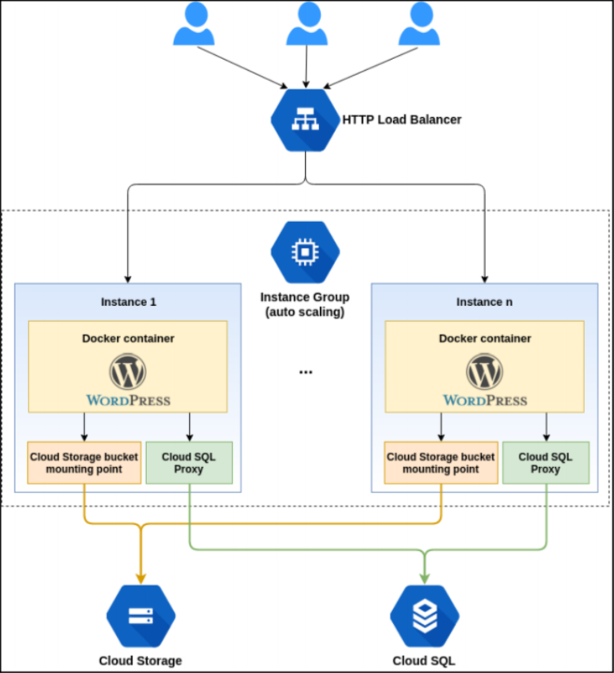
System Architecture

Slide 17
Result Analysis
This is the dataset used to query with Interactive and batch query
The dataset is queried before and after using scheduling approach.
The bar chart is plotted for amount of time taken by each query to process the dataset.
Tabel ID | Table size | Long Term Storage size | Number of Rows
github-nested | 1.58 GB | 1.58 GB | 2,541,639
github-timeline | 3.4 GB | 3.4 GB | 6,219,749
gsod | 16.1 GB | 16.1 GB | 114,420,316
nataility | 21.9 GB | 21.9 GB | 137,826,763
shakespeare | 6.13 MB | 6.13 MB | 164,656
trigrams | 258 GB | 258 GB | 68,051,508
wikipedia | 35.7 GB | 35.7 GB | 313,797,035

Slide 18
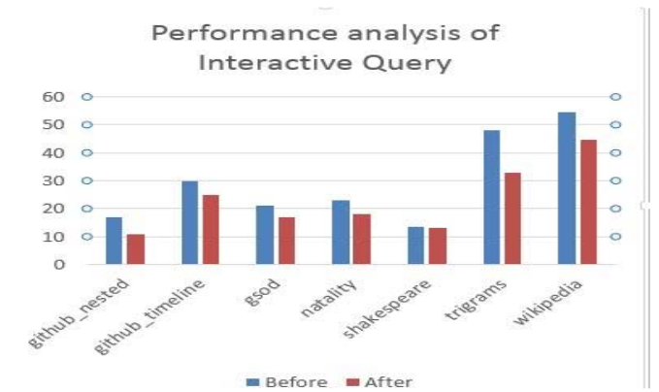
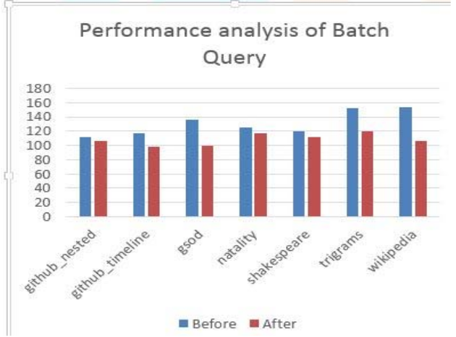
Cont.

Slide 19
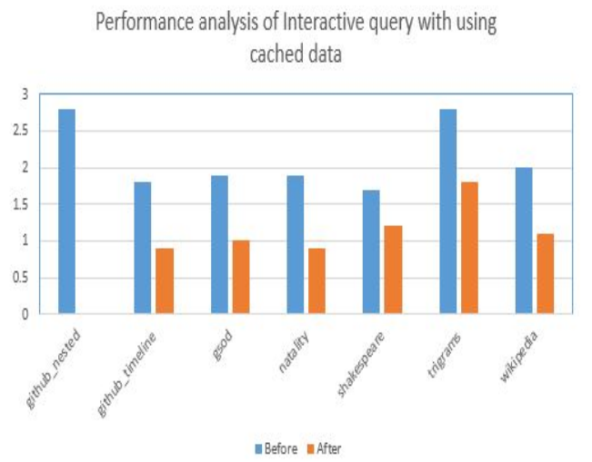
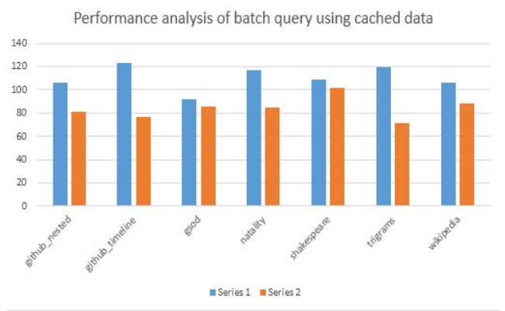
Cont.

Slide 20
Conclusion
Containerization of dockers makes use of linux features that separate the entire system from other applications that makes docker to run fast and accurate.
Kubernetes helps to communicate between the applications and allows to scale the applications as per requirement.
Scheduling approach in BigQuery reduces the query execution time for large databases.

Slide 21
References
[1]. Jay Shah, Dushyant Dubaria, Building Modern Clouds using Docker, Kubernetes & Google Cloud Platform, 2019 IEEE
[2]. Hera Arif, Hassan Hajjdiabl, Fatima Al Harbi , Mohammed Ghazal, A Comparison between Google Cloud Service and iCloudHera, 2019 IEEE 4th International Conference on Computer and Communication Systems.
[3]. Bansari Kotecha, Hetal Joshiyara, Handling Non-Relational Databases on Big Query with Scheduling Approach and Performance Analysis ,2018 IEEE

Slide 22
THANK YOU

